Slide 1

Are Deep Neural Networks the best choice for modeling Source Code?
Vincent J. Hellendoorn & Premkumar T. Devanbu
University of California, Davis
Conference on the Foundations of Software Engineering
Paderborn, Germany, September 8, 2017

Slide 2
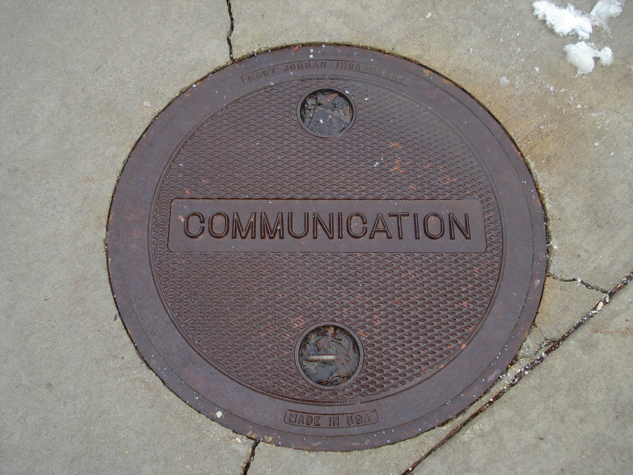
Notes:
Today we study code as an act of communication.
To understand why, we must look back. For most of the 20th century, the field of linguistics studied natural languages in a formal framework, using grammars and formal rules.
In the 1970s, the rise of computational power began to change this: some linguists turned to corpus-based studies instead. These studies added a powerful complementary understanding of how people actually used language.
Among the many resulting insights, perhaps the most interesting one was that people use language in astonishingly predictable and repetitive ways!
This allows the construction of statistical language models that power many of todays language-related innovations, like Alexa, auto-correct.

Slide 3
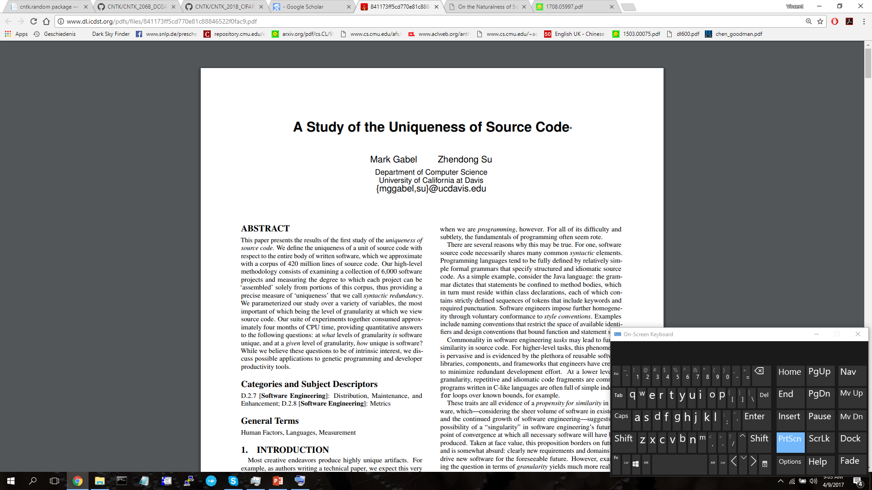
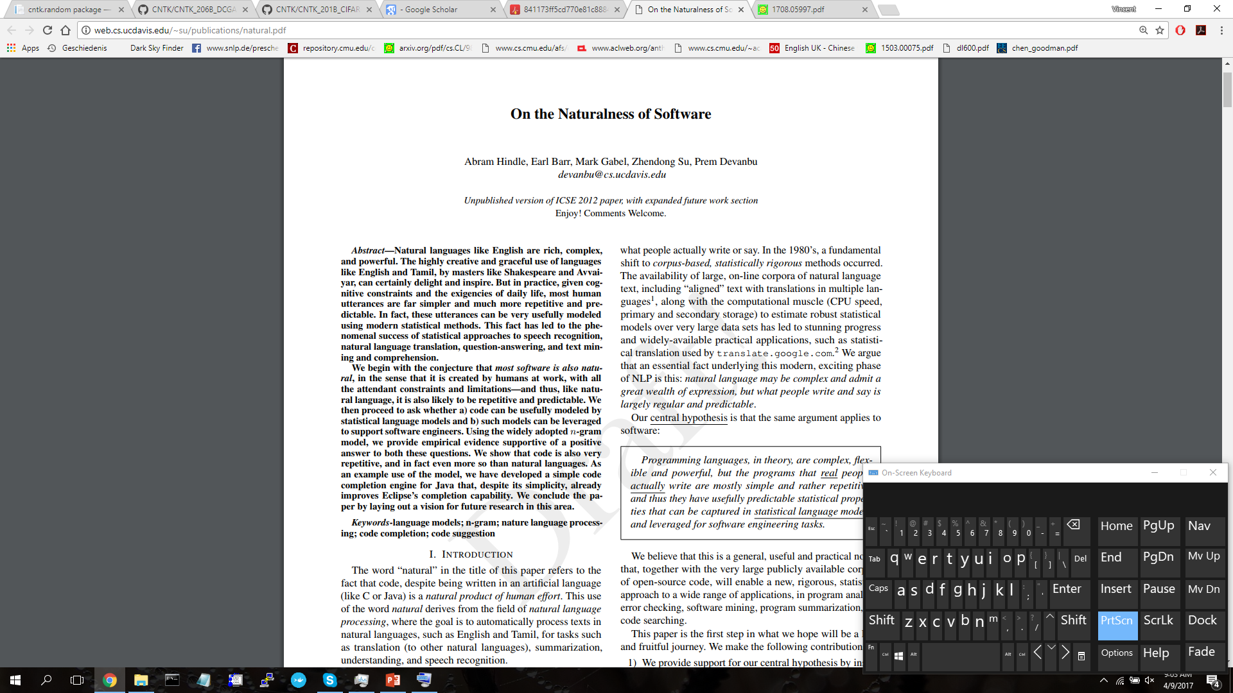
Notes:
Now, in the last decade, we have seen a boom in data-driven SE research: vast amounts of code and communication about that code have entered the open-source domain, which means that we can now study statistical and behavioral characteristics of what coding actually looks like in the wild; a very similar trend to linguistics.
And one of the main observations that followed was that code, too, is highly predictable and can be effectively modeled in ways similar to natural language.
In other words, as much room as PL grammar gives us to express some arbitrary semantics in infinitely many ways, we tend to flock to idiomatic, predictable phrases and structures, even copying coding patterns within communities.

Slide 4
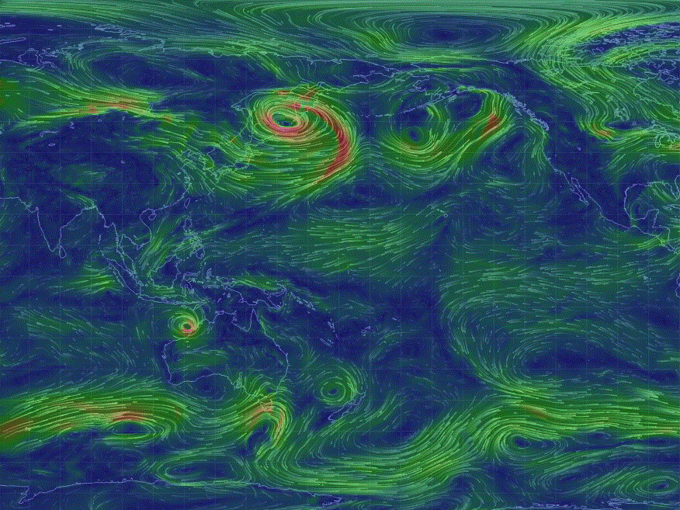
Language Models
http://2.bp.blogspot.com/-BZM7IGRktNM/Ur88sExpo3I/AAAAAAAAB7g/saooI7InCCk/s1600/jetstreamwinds.GIF
Notes:
In computational linguistics, the discovery of these statistical patterns in natural language led to the development of powerful models to capture their repetition and variation.
Traditionally, these language models where count-based, but more recently deep learning has proven successful at capturing more latent patterns in text, especially recurrent neural networks.
I will elaborate on these a bit more later, but for now, suffice it to say that these same models have been applied to source code as well and with great success: source code is even more predictable than natural language!
This has led to all sorts of applications in the last few years, like code completion, fault localization, code synthesis.

Slide 5
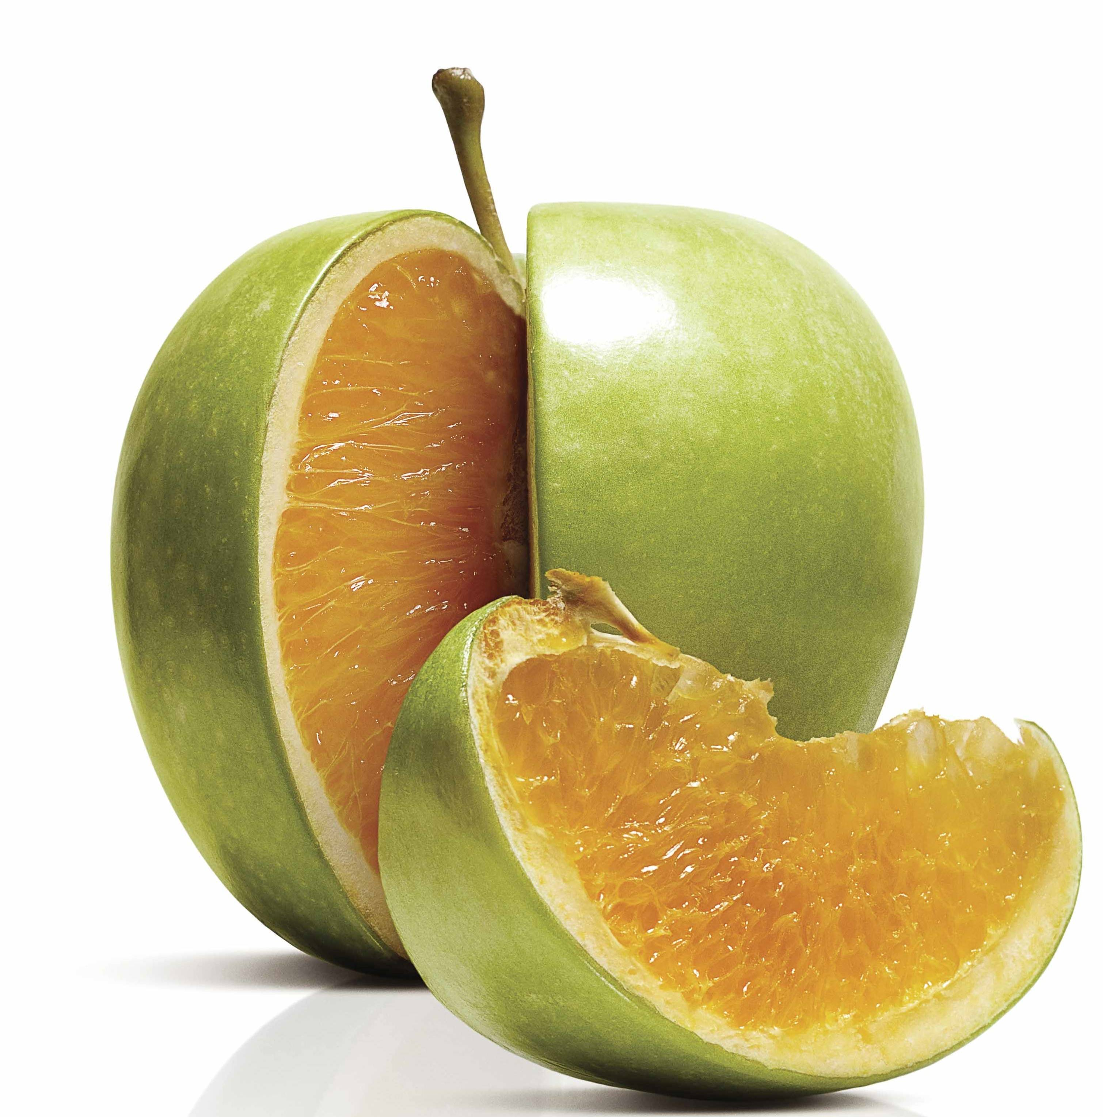
Challenges
- Vocabulary
- Evolution
+ Many Scopes
http://freakonomics.com/wp-content/uploads/2011/04/new-apple-orange-small.jpg
Notes:
But there’s a problem: the analogy must end somewhere. Code is not quite like natural language and we must understand how it is and isn’t.
(Discuss vocabulary issues, dynamic re-estimation)
But this works the other way too: code is exceedingly local in nature and capturing this can greatly improve language models. Tu et al. proved this in 2014 and we shall see more today.

Slide 6
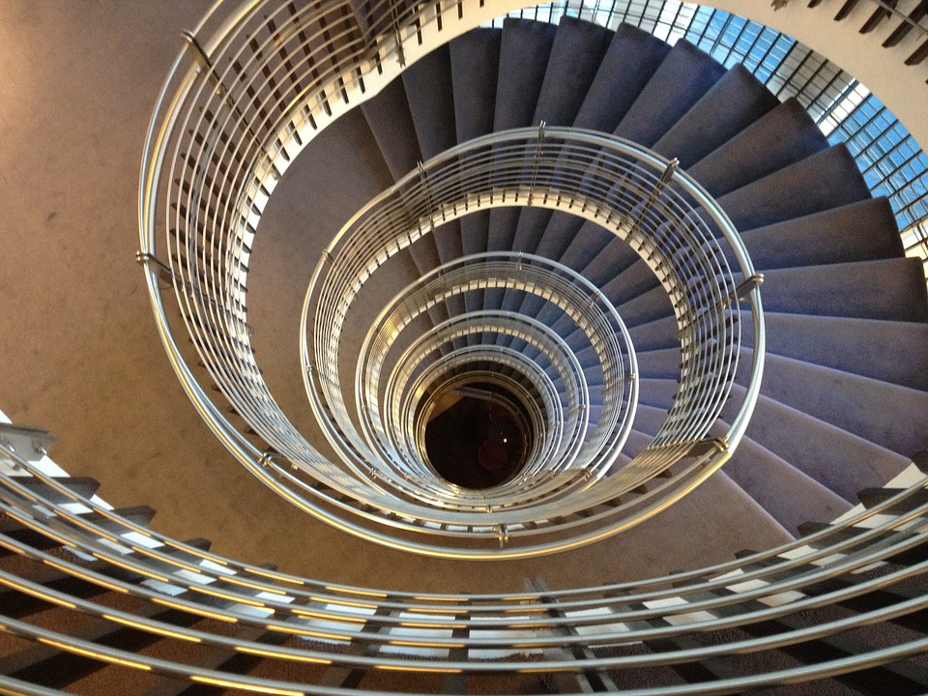
https://cdn.pixabay.com/photo/2013/09/08/19/10/spiral-staircase-180536_960_720.jpg
Notes:
This is the motivation for our work. The application of natural-language inspired modeling to source code has proven fruitful and useful, and is here to stay.
But if we want to make the most of these models, we must understand them in the scope of our own community and create standards accordingly.
We show a step towards this goal today by presenting dynamic, nested n-gram models.
By integrating SE notions of vocabulary, evolution and scopes into an n-gram model, we create a model that is substantially more powerful for source code than traditional language models, and proves surprisingly complementary with deep learning models.

Slide 7
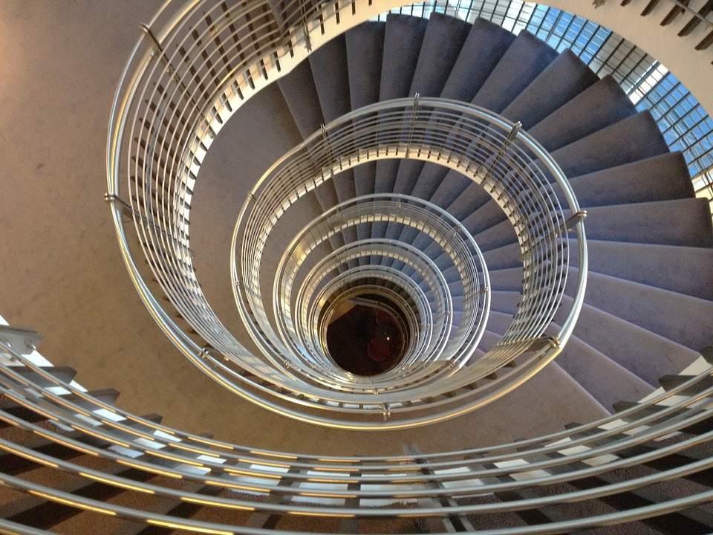
Structure
A bit more background
Our contributions
Where do we go?
https://cdn.pixabay.com/photo/2013/09/08/19/10/spiral-staircase-180536_960_720.jpg

Slide 8
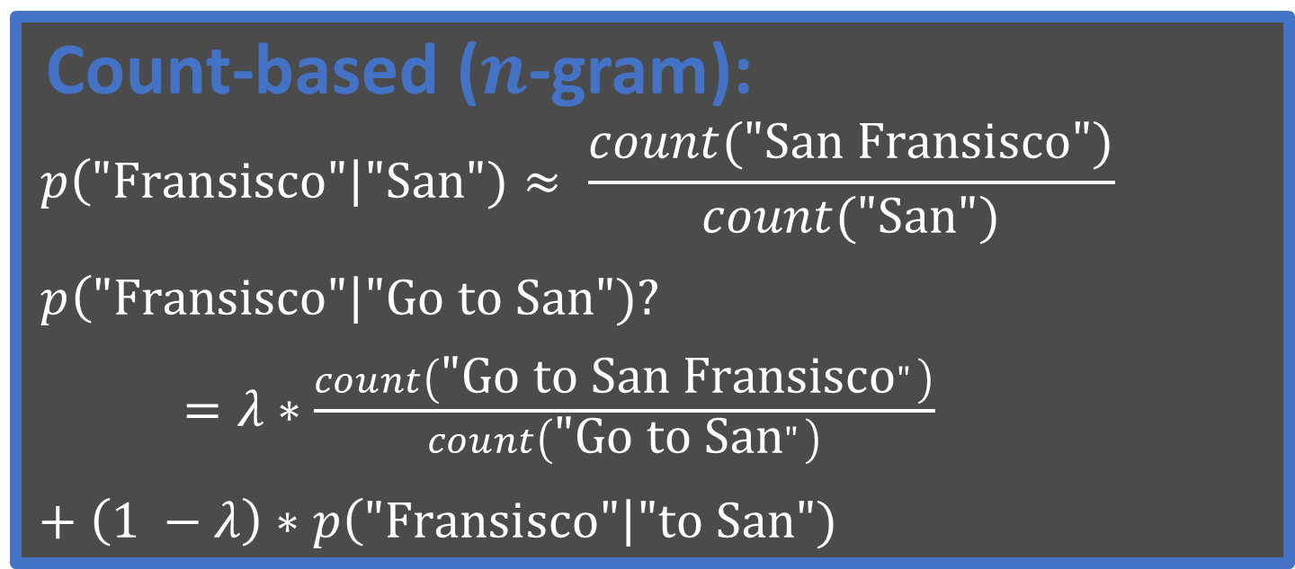
Language Models
Count-based ($n$-gram):
$$p\left("\text{Fransisco}\text{"}\right|\text{"}\text{San}")≈ \frac{count("\text{San} \text{Fransisco}")}{count("\text{San}")}$$
$p\left("\text{Fransisco}\text{"}\right|\text{"}\text{Go} \text{to} \text{San}")?$
$=λ∗\frac{count\left(\text{"}\text{Go} \text{to} \text{San} \text{Fransisco}"\right)}{count\left(\text{"}\text{Go} \text{to} \text{San}"\right)}$
$+ \left(1 −λ\right)∗p\left("\text{Fransisco}\text{"}\right|\text{"}\text{to} \text{San}")$
http://2.bp.blogspot.com/-BZM7IGRktNM/Ur88sExpo3I/AAAAAAAAB7g/saooI7InCCk/s1600/jetstreamwinds.GIF
Notes:
Note: in our paper we compare a wide variety of smoothing techniques and find surprising differences with NLP

Slide 9

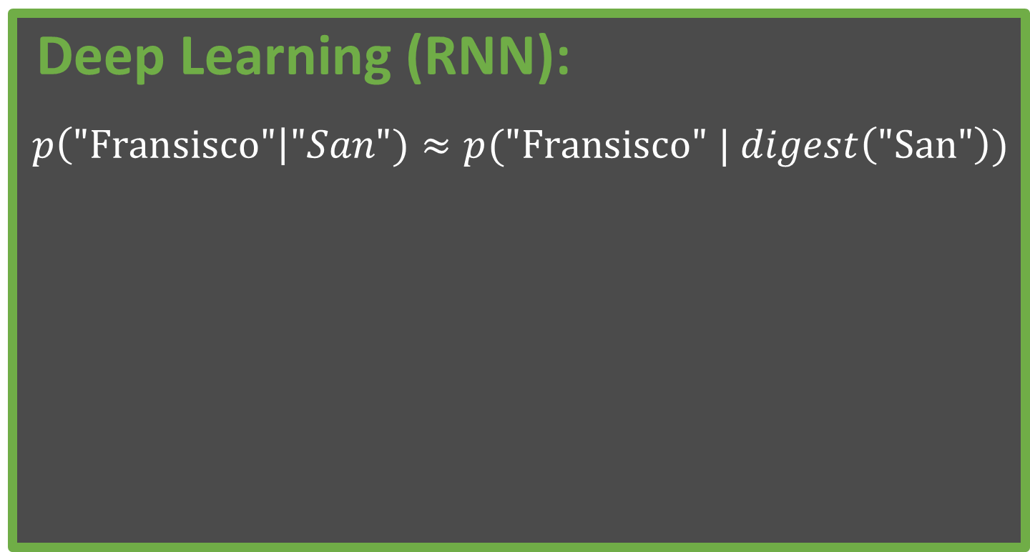
Language Models
Deep Learning (RNN):
$$p\left("\text{Fransisco}\text{"}\right|"San")≈p("\text{Fransisco}" | digest\left("\text{San}"\right))$$
http://2.bp.blogspot.com/-BZM7IGRktNM/Ur88sExpo3I/AAAAAAAAB7g/saooI7InCCk/s1600/jetstreamwinds.GIF
Notes:
Note: you can stack these too.
Note: we use both a one-layer 300-dim network and a 2-layer 650 dim network. The latter took about 1 day to train on the 16M tokens.

Slide 10
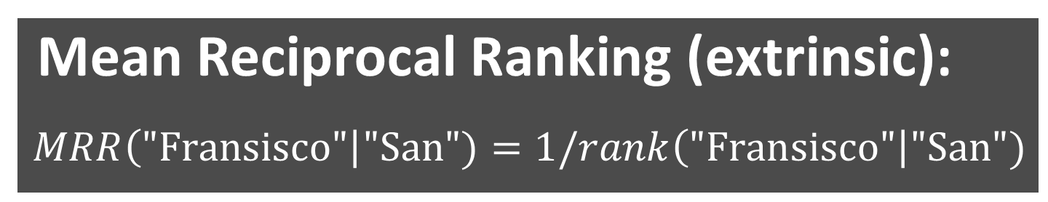
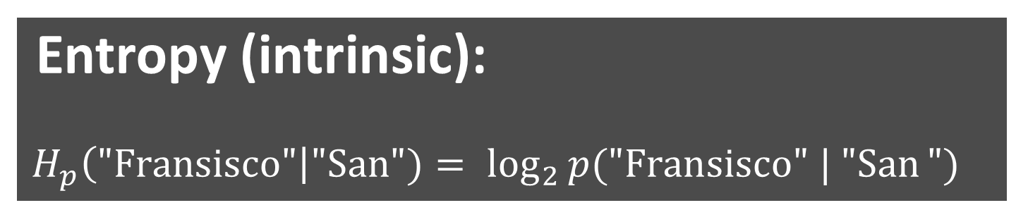
Evaluating Models
Entropy (intrinsic):
$$H_{p}\left("\text{Fransisco}\text{"}\right|\text{"}\text{San}")= \log_{2}{p("\text{Fransisco}" | "\text{San}}")$$
Mean Reciprocal Ranking (extrinsic):
$$MRR\left("\text{Fransisco}\text{"}\right|\text{"}\text{San}")=1/rank\left("\text{Fransisco}\text{"}\right|\text{"}\text{San}")$$
http://2.bp.blogspot.com/-BZM7IGRktNM/Ur88sExpo3I/AAAAAAAAB7g/saooI7InCCk/s1600/jetstreamwinds.GIF

Slide 11
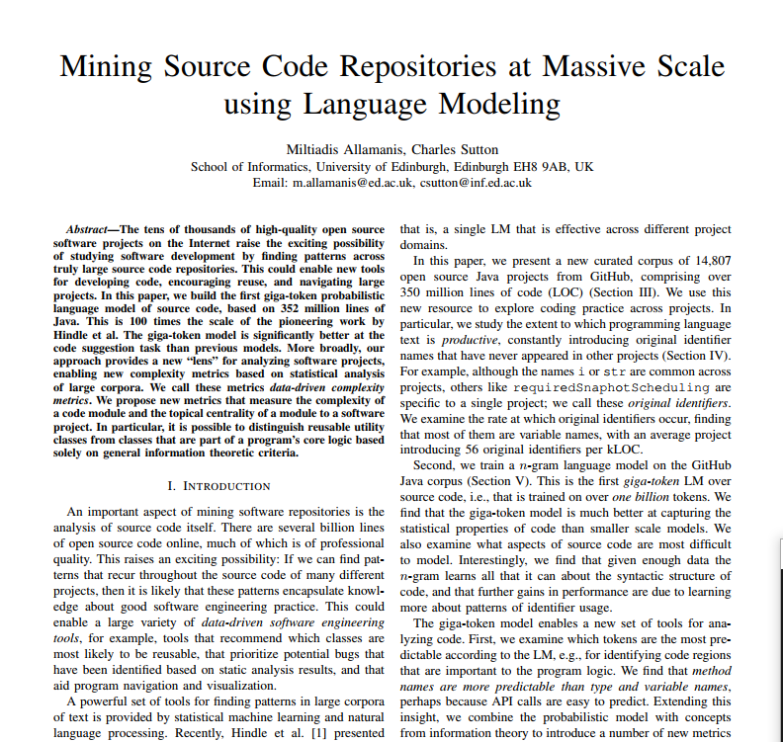
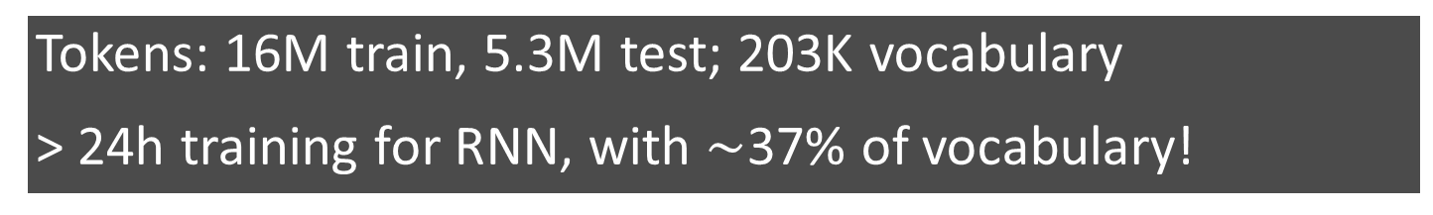
Data
Tokens: 16M train, 5.3M test; 203K vocabulary
> 24h training for RNN, with $\sim$37% of vocabulary!
http://2.bp.blogspot.com/-BZM7IGRktNM/Ur88sExpo3I/AAAAAAAAB7g/saooI7InCCk/s1600/jetstreamwinds.GIF

Slide 12
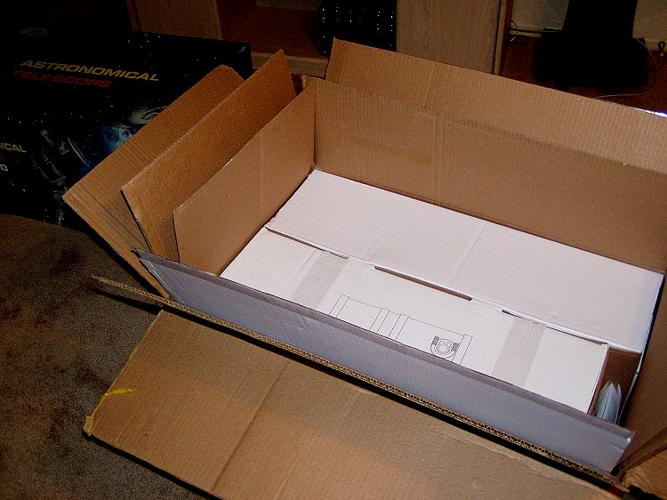
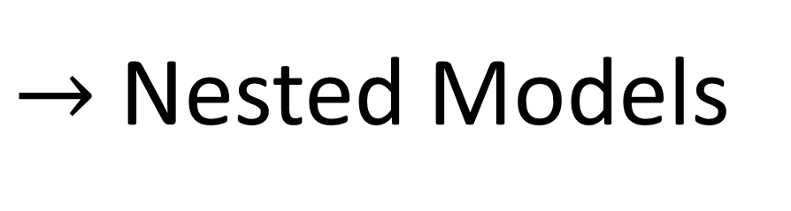
Many Scopes
$→$ Nested Models
Notes:
Note: inter-project versus maintenance setting

Slide 13



Many Scopes
$→$ Nested Models
java
util
lang
awt
Set.java
List.java
Map.java
String.java
Button.java

Slide 14
Many Scopes
$→$ Nested Models
java
util
lang
awt
Set.java
List.java
Map.java
String.java
Button.java
1
Cache

Slide 15

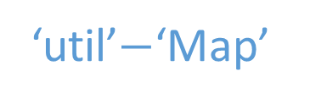
Many Scopes
$→$ Nested Models
java
util
lang
awt
Set.java
List.java
Map.java
String.java
Button.java
2
2
1
‘util’$−$‘Map’
Cache

Slide 16

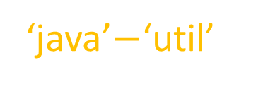
Many Scopes
$→$ Nested Models
java
util
lang
awt
Set.java
List.java
Map.java
String.java
Button.java
2
2
1
3
3
‘util’$−$‘Map’
Cache
‘java’$−$‘util’

Slide 17
Many Scopes
$→$ Nested Models
4: Other Projects
java
util
lang
awt
Set.java
List.java
Map.java
String.java
Button.java
2
2
1
3
3
‘util’$−$‘Map’
Cache
‘java’$−$‘util’

Slide 18
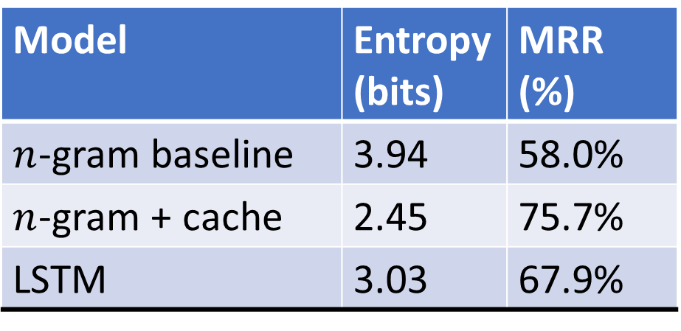
Many Scopes
$→$ Nested Models
Model | Entropy (bits) | MRR (%)
$n$-gram baseline | 3.94 | 58.0%
$n$-gram + cache | 2.45 | 75.7%
LSTM | 3.03 | 67.9%

Slide 19
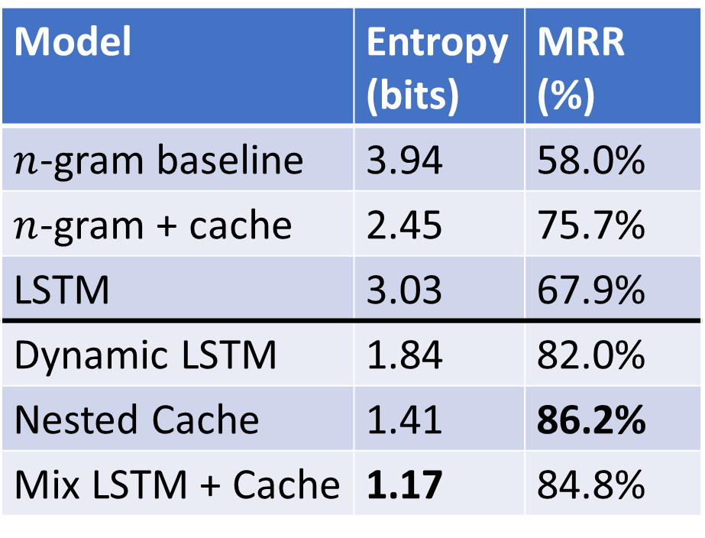
Many Scopes
$→$ Nested Models
Model | Entropy (bits) | MRR (%)
$n$-gram baseline | 3.94 | 58.0%
$n$-gram + cache | 2.45 | 75.7%
LSTM | 3.03 | 67.9%
Dynamic LSTM | 1.84 | 82.0%
Nested Cache | 1.41 | 86.2%
Mix LSTM + Cache | 1.17 | 84.8%

Slide 20
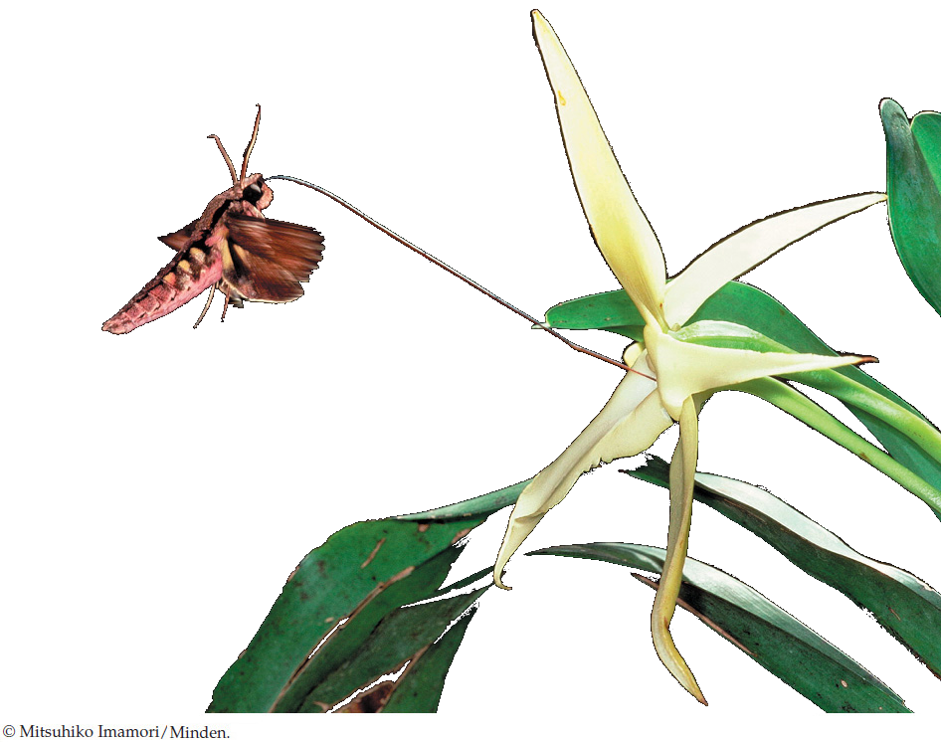
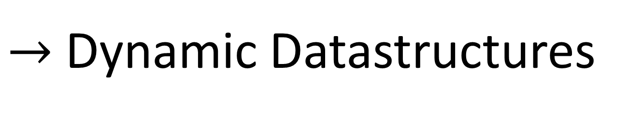
Evolution
$→$ Dynamic Datastructures
http://www.macmillanhighered.com/BrainHoney/Resource/6716/digital_first_content/trunk/test/hillis2e/asset/img_ch21/chapopen21.jpg
Notes:
(to enable the before)

Slide 21
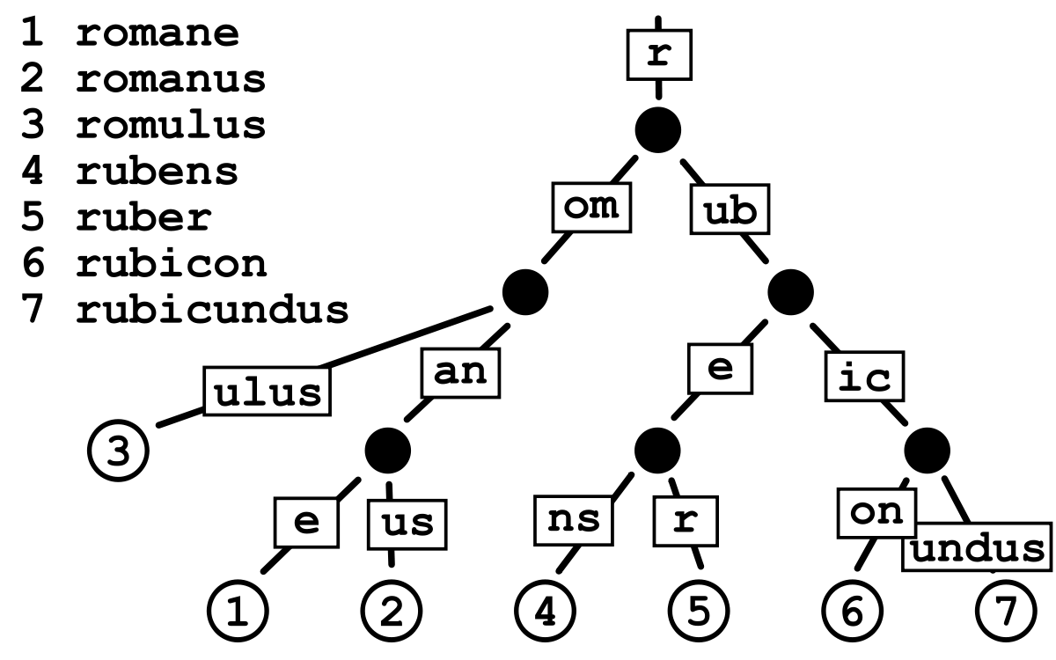
Evolution
$→$ Dynamic Datastructures
- More data-intensive
+ Compress nodes
+ Prediction cache
+ Faster smoothing
https://upload.wikimedia.org/wikipedia/commons/thumb/a/ae/Patricia_trie.svg/1200px-Patricia_trie.svg.png
Notes:
Note: trie is normal, we store counts instead of probabilities!
Note: more data-intensive not just because of more ints, but also can’t optimize before evaluation!

Slide 22
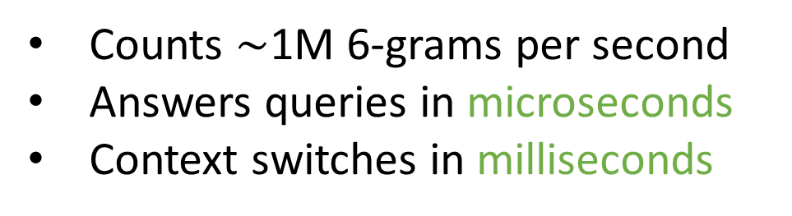
Evolution
$→$ Dynamic Datastructures
Counts $\sim$1M 6-grams per second
Answers queries in microseconds
Context switches in milliseconds
Try it: www.github.com/SLP-Team/SLP-Core
https://upload.wikimedia.org/wikipedia/commons/thumb/a/ae/Patricia_trie.svg/1200px-Patricia_trie.svg.png

Slide 23
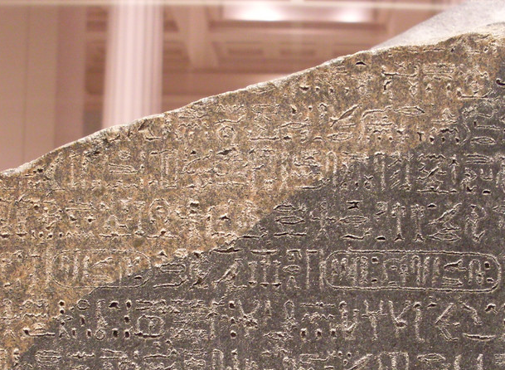
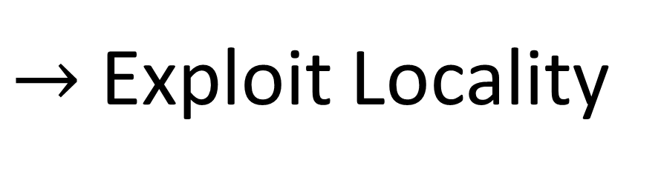
Vocabulary
$→$ Exploit Locality
https://c2.staticflickr.com/4/3265/3126016983_6a7ed497db_b.jpg

Slide 24
Vocabulary
$→$ Exploit Locality
Closed Vocabulary
True Baseline
Notes:
Note: 5 times “more predictable” in terms of entropy too

Slide 25
Vocabulary
$→$ Exploit Locality
Cache Component
Closed Vocabulary
True Baseline

Slide 26
Vocabulary
$→$ Exploit Locality
Closed Vocabulary Cache
Cache Component
Closed Vocabulary
True Baseline

Slide 27
Vocabulary
$→$ Exploit Locality
Model | Entropy (bits) | MRR (%)
Dynamic LSTM | 1.84 | 82.0%
Nested Cache | 1.41 | 86.2%
Mix LSTM + Cache | 1.17 | 84.8%
Entropy (bits) | MRR (%)
 | 63.8%
 | 81.8%
 | 77.2%
Notes:
Note: the LSTM could not learn all words even if it tried!

Slide 28
Vocabulary
$→$ Exploit Locality
Model | Entropy (bits) | MRR (%)
Dynamic LSTM | 1.84 | 82.0%
Nested Cache | 1.41 | 86.2%
Mix LSTM + Cache | 1.17 | 84.8%
Entropy (bits) | MRR (%)
3.93 | 63.8%
1.92 | 81.8%
1.25 | 77.2%
Notes:
Note: the LSTM could not learn all words even if it tried!

Slide 29
Where next?
Exploit what we Know
Tailor DNN for Code
Explore Linguistics of Code

Slide 30


Questions
This material is based upon work supported by the National Science Foundation under Grant No. 1414172
www.github.com/SLP-Team/SLP-Core
vhellendoorn@ucdavis.edu
vhellendoorn.github.io
https://cdn.pixabay.com/photo/2013/09/08/19/10/spiral-staircase-180536_960_720.jpg

